Slide 1



_{Ready Analysis:}
Vertex Financial Services Supervisor Application
_{January 29}^{th}_{, 2008}

Slide 2
Agenda
Project Goals
Application Overview
Migration Requirements
Preliminary Project Structure
Migration Estimate and Cost
Open Discussion

Slide 3
Project Goals
Goal | Proposed Solution
Move away from an unsupported platform | Microsoft has announced the termination of support for Visual Basic 6.0 for March, 2008. Converting the application to C# moves Vertex Financial Services away from a legacy development environment and into a fully supported platform moving forward

Slide 4
Vertex Supervisor
Application Overview
Lines of Code per Project (VB6)
Project | Effective Lines of Code
MSGOCX | 6,933
OSGInterfaces | 150
Security | 315
SecurityMgt | 32
Supervisor | 157,021
Total Effective Lines of Code | 164,451

Slide 5
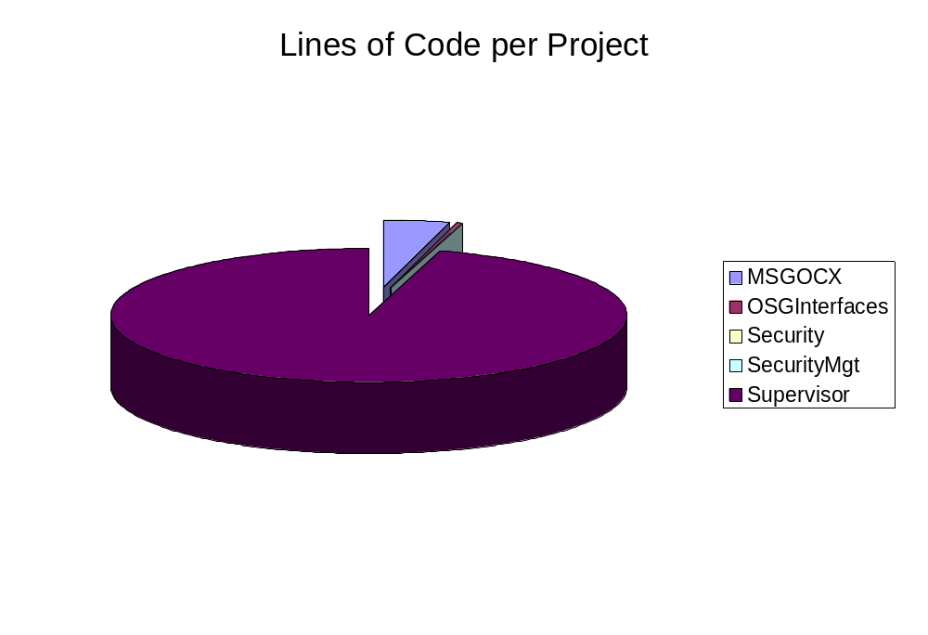
Vertex Supervisor application overview

Slide 6
Migration Requirements
String Replacements
  Replace the string Marlborough Stirling with Vertex Financial Services
Circular Dependencies
  Remove the Circular reference between the Security and SecurityMgtInterface projects by merging them into one project

Slide 7
Migration Requirements
ADO to ADO.NET Conversion
  Replace the ADO code with ADO.NET:
  Use the ADO.NET SQLClient Data Provider
    Uses .NET classes directly
    Familiar schema for developers
  Use ADO.NET System.Data.Common with Helper Classes
    Helper classes follow ADO.NET 2.0 class hierarchy
Additional Database Concurrency Testing may be necessary once the application reaches functional equivalence
  Performed on a Time and Materials basis

Slide 8
Migration Requirements –
Third Party Components
Supported by the VBUC
Component | Target Component
Microsoft Common Controls (MSComctlLib) | System.Windows.Forms
Microsoft XML (MSXML) | System.XML
Microsoft Common Dialog Controls (MSComDlg) | System.Windows.Forms
Microsoft Masked Edit Box (MSMask) | System.Windows.Forms. MaskedTextBox
Scripting.FileSystemObject Scripting.TextStream | System.IO Classes System.IO.FileStream
Microsoft Tabbed Dialog Control (TabDlg) | System.Windows.Forms. TabControl

Slide 9
Migration Requirements –
Third Party Components
Manual Conversion
Component | Target Component
Microsoft DataGrid Control (MSDataGridLib) | System.Windows.Forms. DataGridView*
Microsoft DataList Controls (MSDataListLib.DataCombo) | System.Windows.Forms. ComboBox*
MSXML2.ServerXMLHTTP | Implemented using System.Net.HttpWebRequest* and System.Net.HttpWebResponse*
* Slight differences in functionality (Splits and Bookmarks are not directly supported in the target components)

Slide 10

Determining Size and Complexity
EWIs, Compile Errors
VB6 Source Code
Source Code
Statistics
Repository
Automatic migration
Files, LOCs, PMEs and Potential issues
Analysis tools

Slide 11
Preliminary Project
Structure – Milestones*
Milestone 1: Solve all EWIs and compilation errors on:
    MSGOCX.vbp
    OSGInterfaces.vbp
    Security.vbp
    SecurityMgtprojects.vbp
  Merge the Security and SecurityMgt projects
Milestone 2: Migrate the Supervisor framework**
    Global Parameters Screen
Milestones 3 and 4: Migrate the remainder of the application
* Vertex will receive the code when each milestone is reached
** The files that go into each milestone will be determined by Vertex for the Statement of Work

Slide 12
Preliminary Project
Structure
Kickoff
Setup
Start the migration
in March 2008
Completed by June 30, 2008
The specific timelines for each milestone will be decided later on
Functional
Equivalence
Automatic Migration
M0: Green Code
M1: Components and Support Projects
M2: Supervisor Infrastructure
M3: Supervisor Features I
M4: Supervisor Features II
Testing / QA
Stabilization
Accept. Testing
Final Acceptance
Concurrency Testing Support*
Mar
08
Apr
08
May
08
June
08
July
08
ArtinSoft
Vertex

Slide 13
Migration Estimate and
Cost
Supervisor Migration (Fixed Cost)
Item | Time | Pricing
Supervisor Code migration from VB6 to C# and the .NET Framework | 4 months | 106,916 GBP
Visual Basic Upgrade Companion License | N/A | 8,222 GBP
Total for Complete Code | 4 months | 115,138 GBP
Additional Support for Database Concurrency Testing
Item | Time | Price/hour
Price per hour of support for additional database concurrency testing | 1h | 70 BP

Slide 14
Open Items for
Discussion
Next Steps
  Project Approval
  Statement Of Work
  Assign Files to Milestones
Time Frame
  Project start date
    Begin work on March, 2008.
  Target completion date

Slide 15

Thank You…
Questions?

